Slide 1
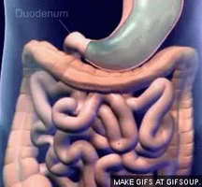
Absorption
AEHBY ATAR Human Biology

Slide 2
Review
What is lymph? Which substances are transported through lymph rather than blood vessels? Why?
List the factors assisting absorption at the alveoli.
List the enzymes produced/active in the small intestine.
Draw the fluid mosaic model.

Slide 3
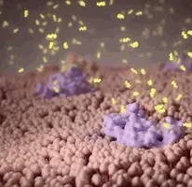
Learning Intentions
Absorption requires nutrients to be in a form that can cross cell membranes into the blood or lymph and occurs at different locations, including the small intestine and large intestine.

Slide 4
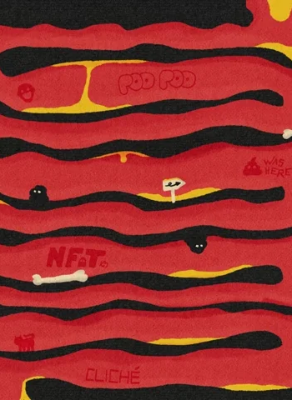
Success Criteria
Identify the substances absorbed in the digestive system.
Draw or label a villi, showing epithelial cells, capillaries and lacteal.
Compare and contrast the small and large intestine, in terms of microscopic structure and substances absorbed.

Slide 5
Digestion and absorption
Mechanical digestion involves the physical breakdown of food but does not alter its chemical makeup.
Chemical digestion, reduces food into its chemical building blocks, which are able to be absorbed.

Slide 6
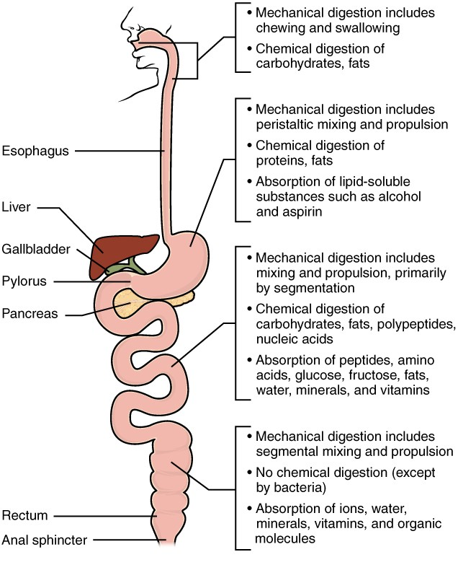


Slide 7
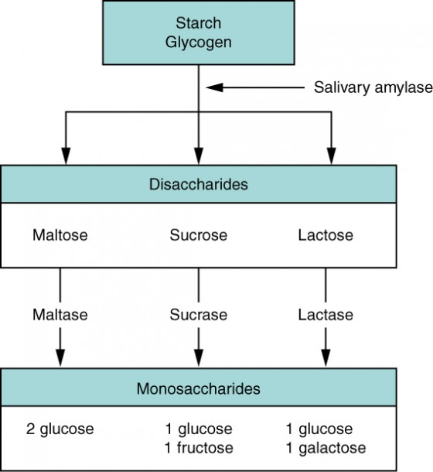

Slide 8
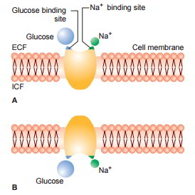
Carbohydrate absorption
Simple sugars (glucose, fructose, and galactose) are absorbed in the small intestine by facilitated diffusion (channel proteins) or active transport (carrier proteins) and pass into the capillaries.

Slide 9
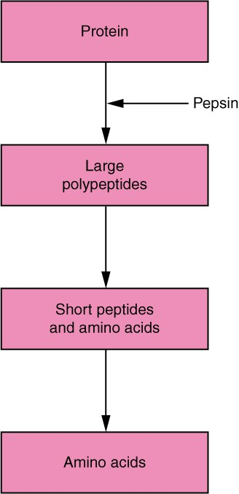

Slide 10
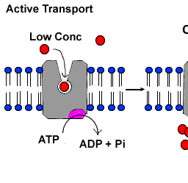
Protein absorption
Amino acids are absorbed by active transport using carrier proteins and pass into the capillaries.

Slide 11
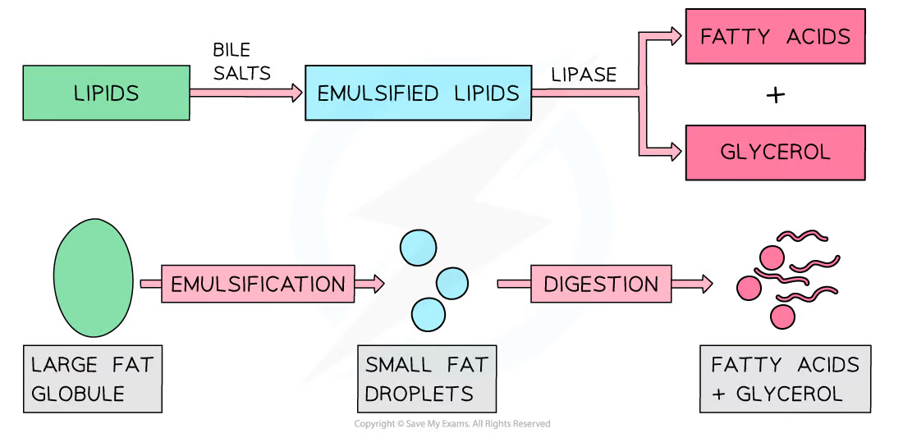

Slide 12
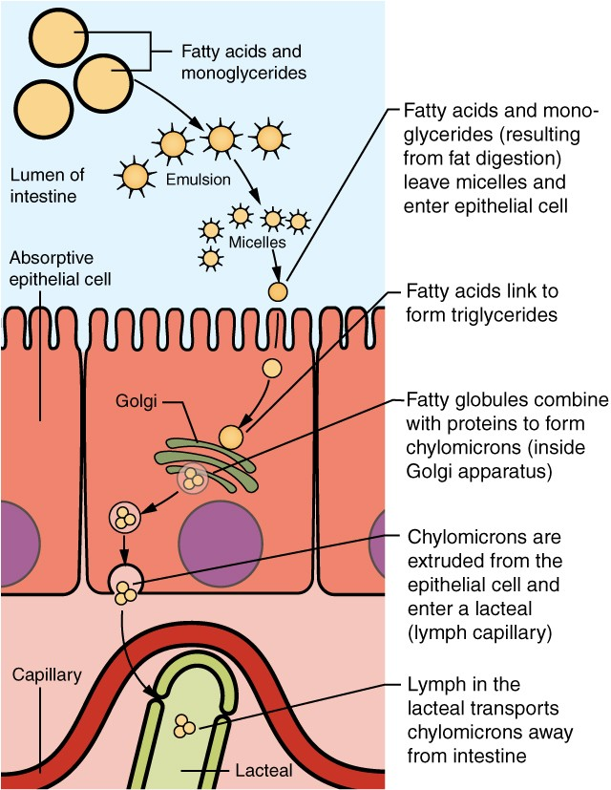
Absorption of lipids
Fatty acids and glycerol are absorbed by simple diffusion, reform to form tiny droplets of lipids and are transferred to the lacteals, (rather than blood capillaries).
(Fat soluble vitamins, (A and E) are also absorbed with lipids).

Slide 13
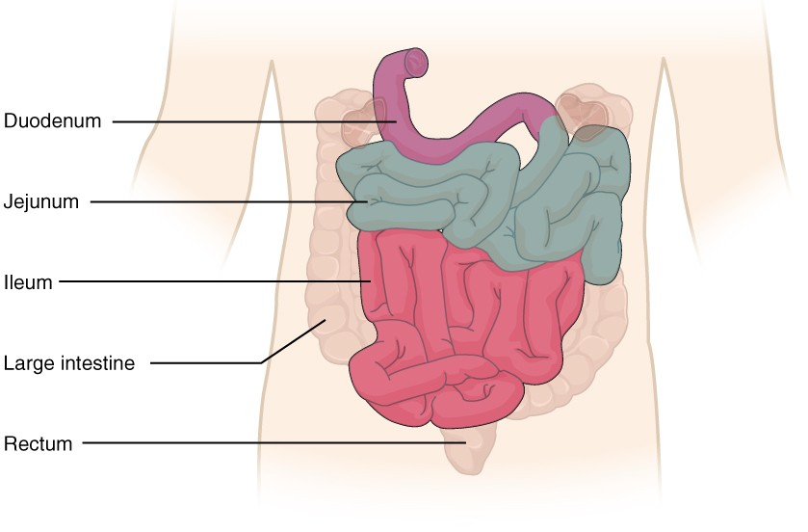

Slide 14
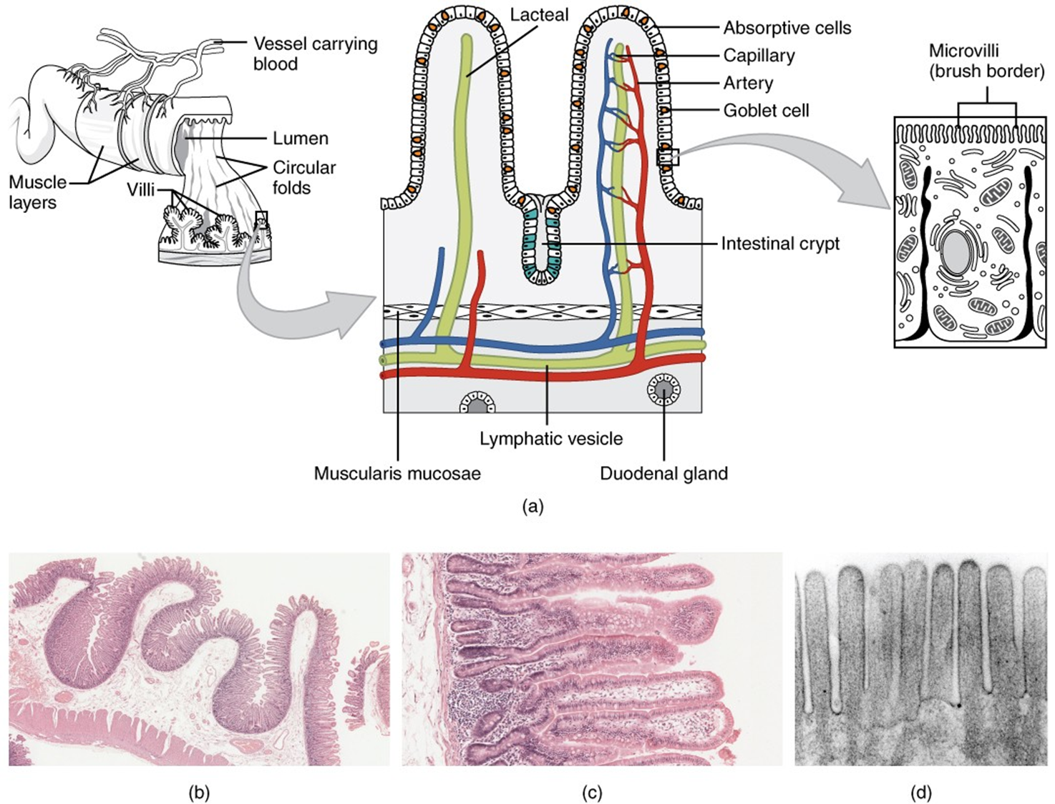

The small intestine

Slide 15


Slide 16
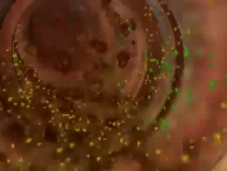

Slide 18
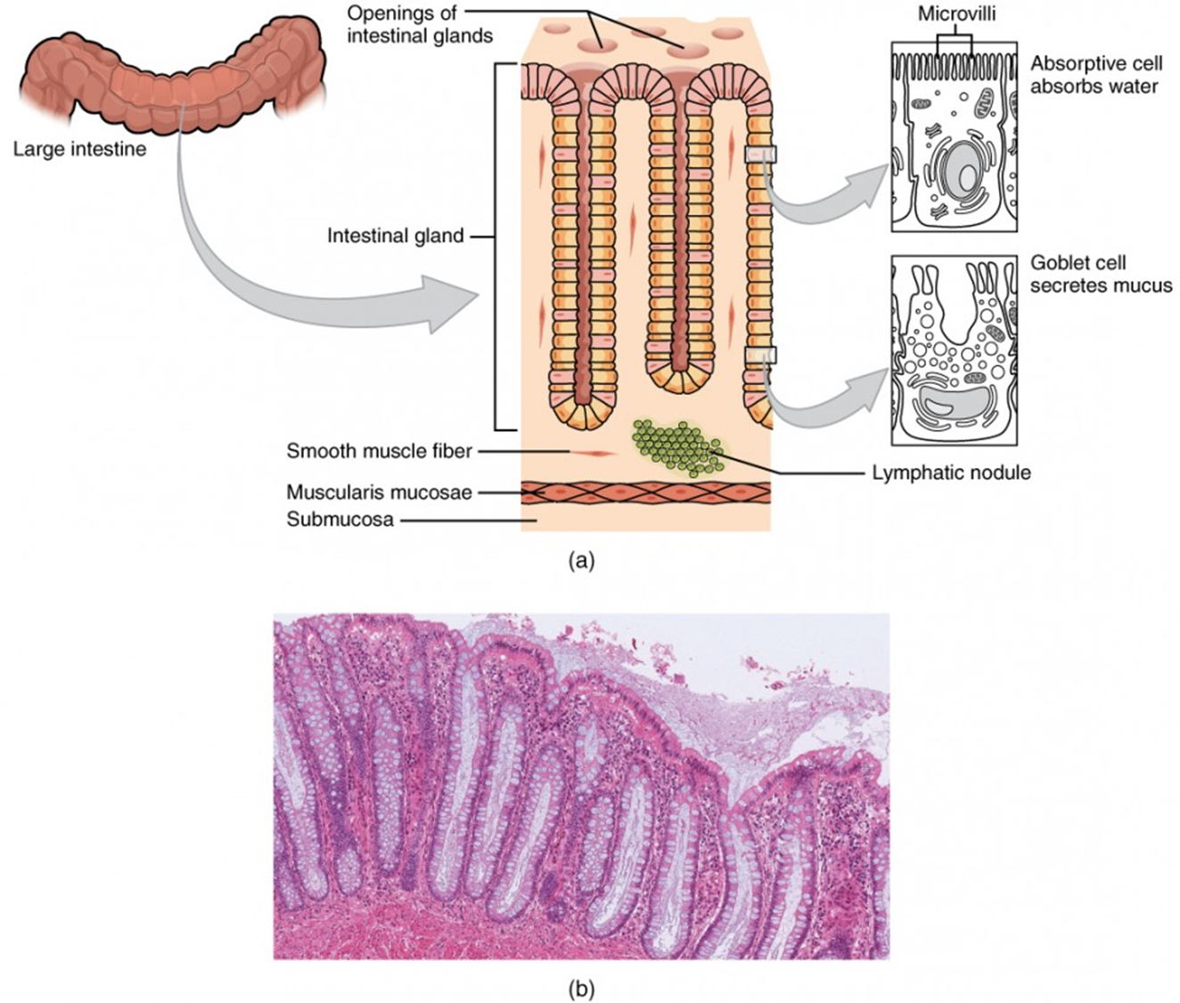
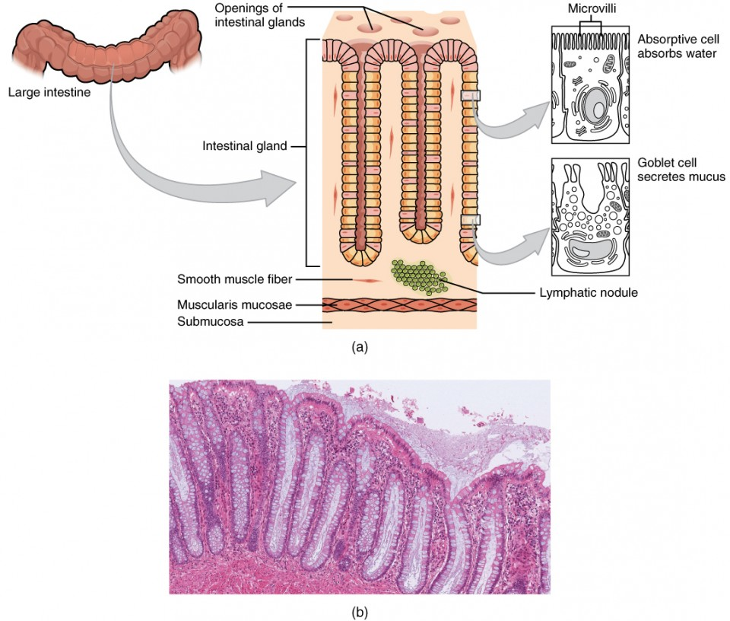
The large intestine

Slide 19
Success Criteria
Identify the substances absorbed in the digestive system.
Draw or label a villi, showing epithelial cells, capillaries and lacteal.
Compare and contrast the small and large intestine, in terms of microscopic structure and substances absorbed.

